Slide 1
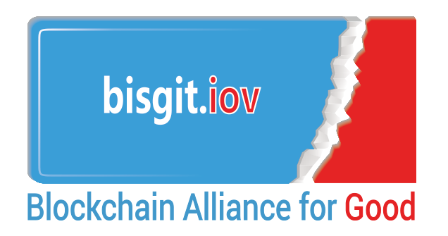
Blockchain for Good and the Internet of Value
EU TCBL Ahtens June 2017
Introduction to the
Seratio Token

Slide 2
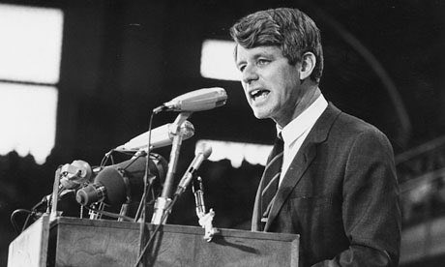
Bobby Kennedy: 'measures everything except that which is worthwhile'
Yet the gross national product does not allow for the health of our children, the quality of their education or the joy of their play. It does not include the beauty of our poetry or the strength of our marriages, the intelligence of our public debate or the integrity of our public officials.
It measures neither our wit nor our courage, neither our wisdom nor our learning, neither our compassion nor our devotion to our country, it measures everything in short, except that which makes life worthwhile
University of Kansas, March 18, 1968
“As the old saying goes,
What gets measured gets done“
Bill Gates (India, April 2017)

Slide 3
Blockchain is focused on the movement of value between entities, the so called ‘internet-of-value’ (IoV). But there are many kinds of value … love has value, kindness has value, generosity has value, Respect has value, emotions have value …
Shouldn’t blockchain capture the movement of all kinds of value - Total Value?

Slide 4
ENABLING STRUCTURAL CHANGE
SOCIAL
TECH
FINTECH
HUM
TECH
Seratio
Blockchain
advances in
Social-Tech and Humanitarian-Tech allows us to Measure and Capture Value and now with Fintech’s blockchain we can transact it to enable significant structural change in our society

Slide 5
The Seratio Blockchain USP
Ordinary blockchain captures hard,
tangible, and financial assets only
Seratio blockchain includes soft,
non-financial and intangible values
Total Block Value

Slide 6
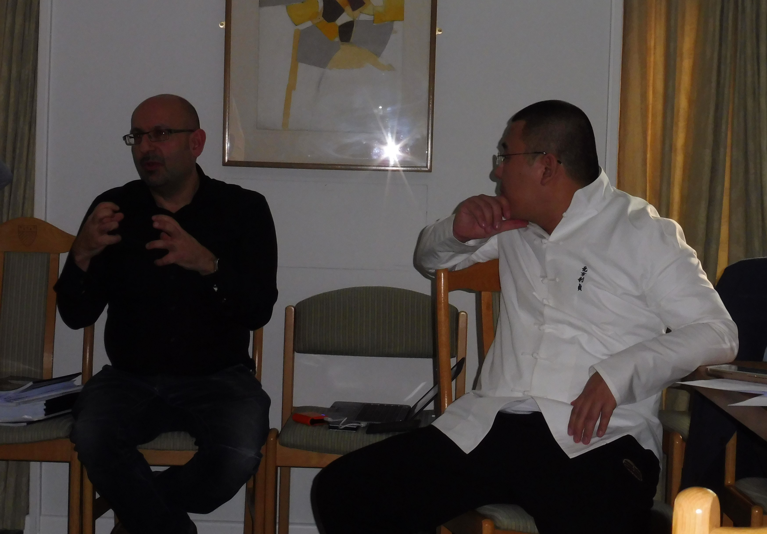
This is the next bitcoin … it’s higher than bitcoin
CCEG Internet-of-Value University of Cambridge Conference, November 2016
Chandler Guo

Slide 7
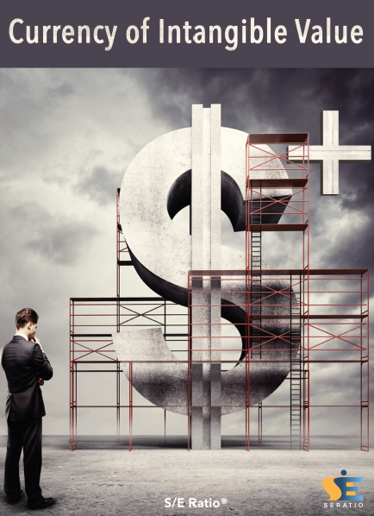
So what Sort of things can you do with a seratio blockchain?
Cryptocurrency + Intangible value
Blockchain plus. A family of crypto-currencies building in a unique record of intangible value to demonstrate the total value of any transaction. The currencies are united by a value and settlement guarantee. A familiar ICO, which may be aligned to a community group value or a Corporate goal. Each block carries the hard-tangible value of the transaction, together with the intangible value record of the giver and receiver. Transactions can be made dependent upon impact or value creation.
Token Cryptocurrency
A reward token system as a tool for recognition. Incorporating all the capabilities of full cryptocurrency, the block carries the intangible value of the issuing entity and, over time the receivers. An instrument to distribute the intangible value of an organisation to its supporters of volunteers to gain value/discounts from others. A tool to enable Micro-share participation.
Provenance
Blockchain tracking and recording of product provenance for supply chain management and cradle-to-grave product traceability of tangible and intangible value. The record includes modern slavery, ecological impact, product value and the increase or decrease in the total value of the product.

Slide 8
We have over 35+ commissions requiring the delivery of total value solutions in 2017-18
We are building the open source Seratio SANDBOX and Seratio ENTERPRISE level platforms
Framework agnostic – Multichain, Ethereum (ETC and ETH), Hyperledger, Sky-Ledger, Interledger …

Slide 9
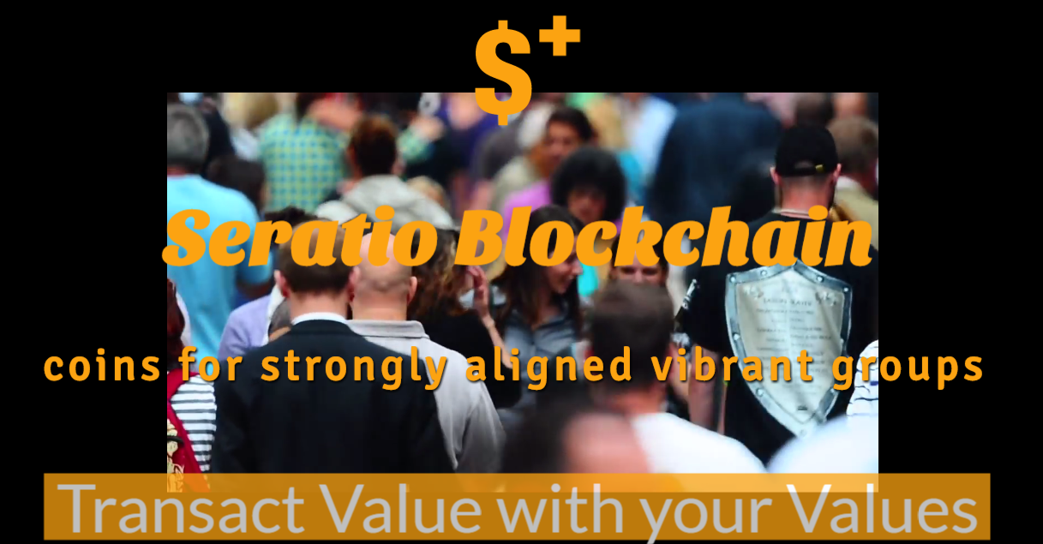

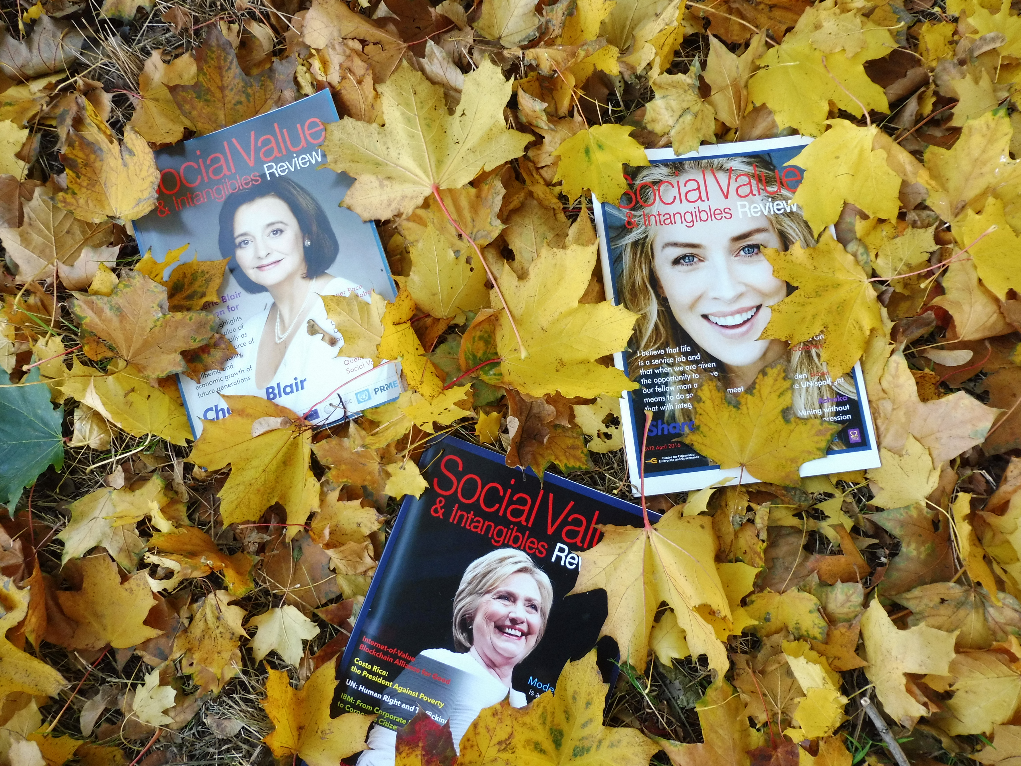
Transact value using values: current projects
Islamic Coin
UN SDG Coin
Women’s Coin
Tokens for Strongly Aligned Vibrant Communities rewarding adherence to religious values. Currently investigating other faith variants with ARC.
http://ow.ly/9nD3306wUdk
Aligned with the values supporting the 17 United Nations Sustainable Development Goals. Impact investment contingent on social outcomes.
http://www.cceg.org.uk/lab
Coins by women, for women, carrying gender based values supporting sisterhood. Circular economy across women communities.
www.womenscoin.com

Slide 10

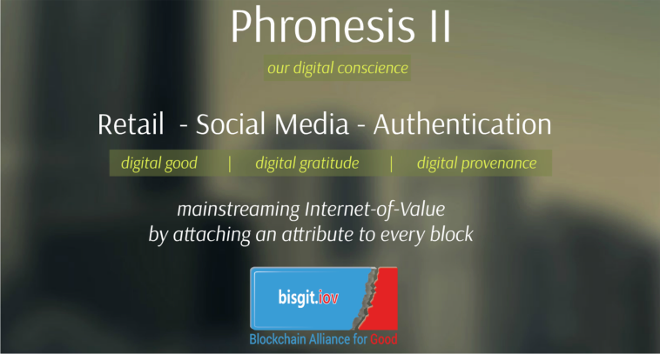

Transact value using values: consumer projects
Social Credit to pay for goods
Make choices based on Provenance
Input your values & let AI U-Bot recommend
Accumulate credit for volunteering and NGO work. At pilot stage for 7 million carers and high street retailers.
https://youtu.be/pHe0ApyeoN4
Across products, companies, processes, projects, people transact on historical attributes of trust and aligned social values.
http://ow.ly/A34u303S4wa
AI-Bot will make learned choices dependent on our value set. Will hunt and form our own personal digital virtual city that meet our social preferences.
https://youtu.be/tdjyoxfuhHs

Slide 11
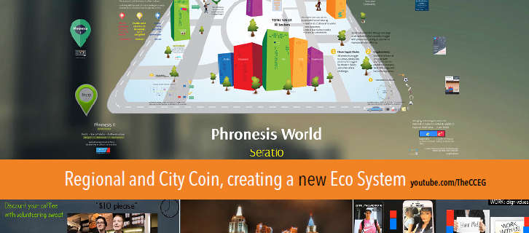
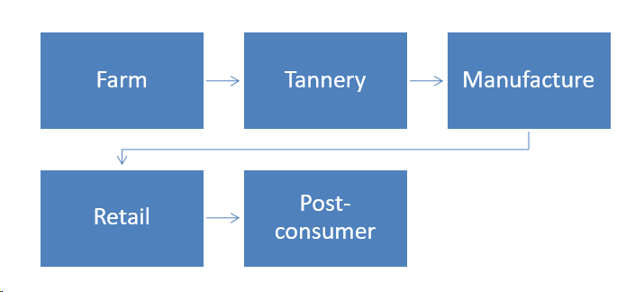

Transact value using values: new projects
City Coin with impact interventions
Transparency in Supply Chains
Life-Long Knowledge Passport: EduCoin
NEW: A major 360º city intervention involving financial, social and geospatial interventions with Metropolis initially piloting 5 cities in the world
NEW: A major 10-man project tracking provenance of leather from cradle to grave for fashion industry
NEW: A UK£20m project targeting a pre-16, Further Education, University and Employer knowledge procurement chain of formal and informal Distributed Learning Ledger
www.cityblockcha.in
http://ow.ly/sNCM30bOzXu
www.cyberfutures.net

Slide 12
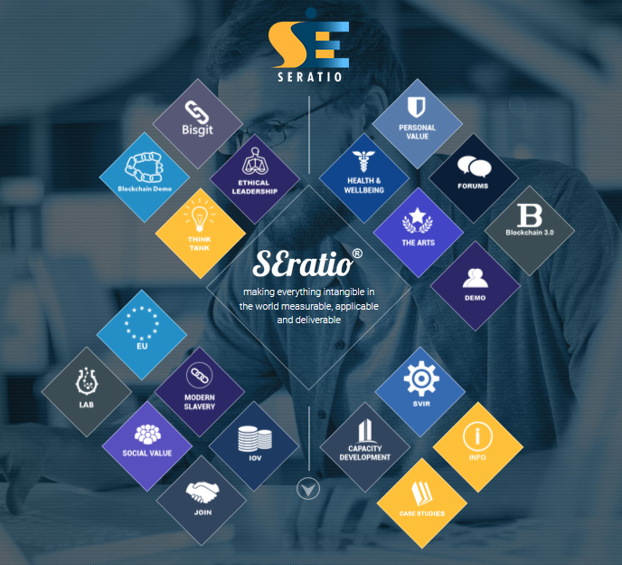
How we Integrate hard and soft values
Regular Blockchain
Bitcoin, ETH, ETC … any hard-tangible-financial Value Token
Proof-of [...]
Caring-faith-impact-happiness … any soft-intangible-NonFinancial Attribute
Distributed S/E Translator

Slide 13
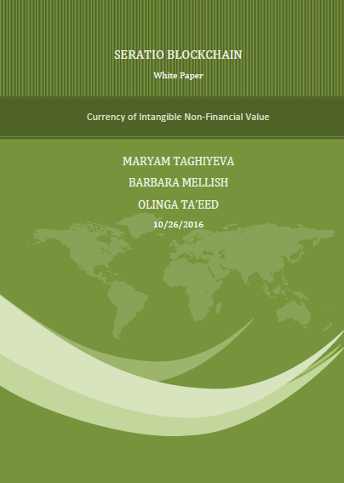
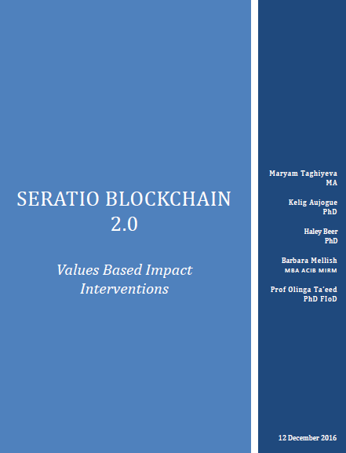
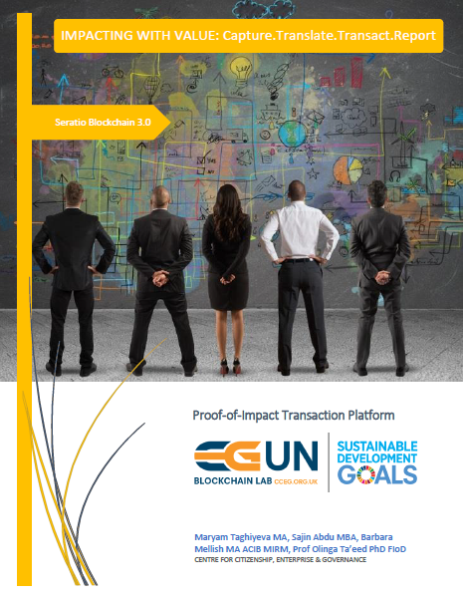
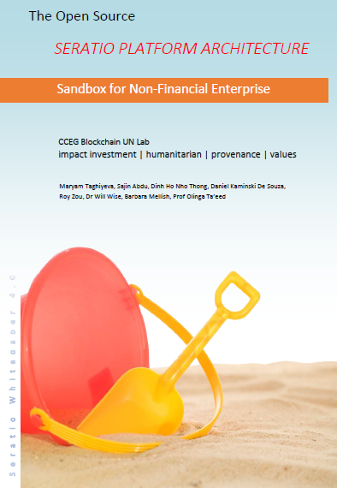
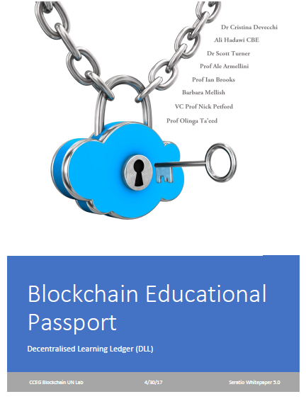
Seratio Whitepaper series
1.0 Currency of Intangible Non-Financial Value
2.0 Values Based Impact Interventions
3.0 Proof-of-Impact Transaction Platform
4.0 Seratio Sandbox Architecture
5.0 Educational Passport: Distributed Learning Ledger
https://github.com/seratio/whitepaper

Slide 14
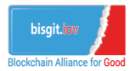
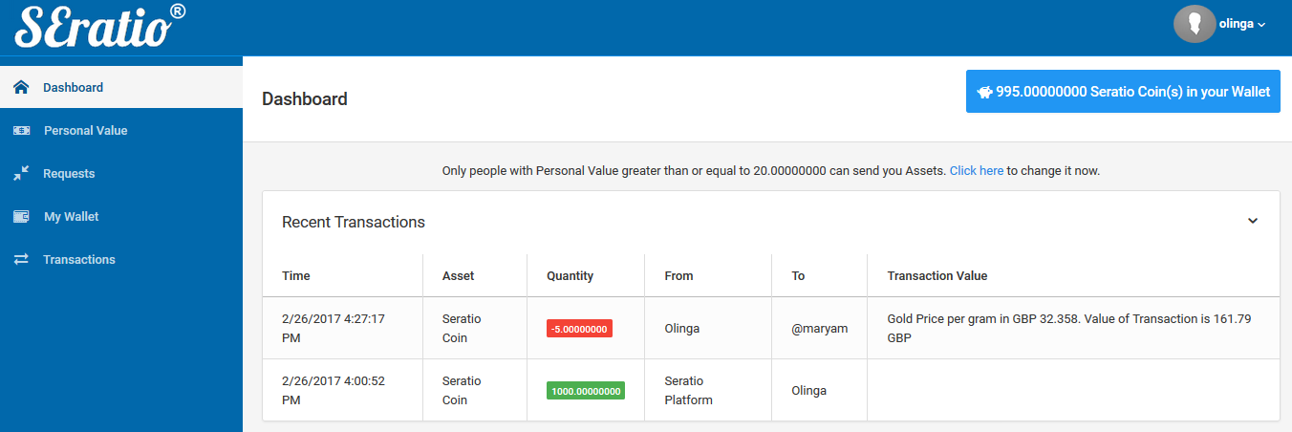
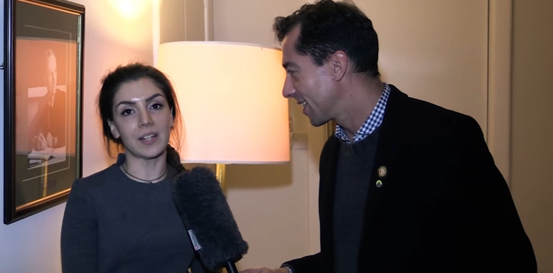
BLOCKCHAIN PRESENCE
Blockchain Alliance for Good
Communications
Proof-of-Concept
www.bisgit.org
Free membership organisation
Cambridge
http://ow.ly/wl1i30aFC4V
Washington and Beijing
http://ow.ly/IB5A30aFBFJ
Latest Newsletter
http://eepurl.com/cCQgJv
http://ow.ly/XLts30bvfEy
Videos
www.youtube.com/user/TheCCEG
Latest Journal
http://ow.ly/mHTx309odXr
Blogs
https://ethereumclassic.github.io/blog/2017-01-06-sustainable-development-goals/
Demo
http://blockchain.seratio.com/
Hackathon
http://ow.ly/zz7n30aFByM
Top 150
http://www.thedigitalmarketingbureau.com/2017/01/18/blockchain-companies-infographic/

Slide 15
So how do we measure the red?
The relationship between the red and blue is called the Social Earnings Ratio.
… and metrics based on S/E have been in development by CCEG since 2011.

Slide 16
World’s leading think tank on the movement of value 60,000+ members 7000 heads of csr of global companies 2000 politicians est. 2011
www.cceg.org.uk

Slide 17
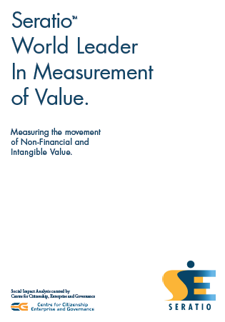
We are at the forefront of the measurement of Non-Financial Value
Digitize All Intangible and Non-Financial Value
Turn Sentiment into Financial Value
Use Fast Data – completed in 10-60 seconds
Measured >UK£ 3 trillion of value http://ow.ly/SYLeS
… and now we Transact Non-Financial Value using Blockchain

Slide 18
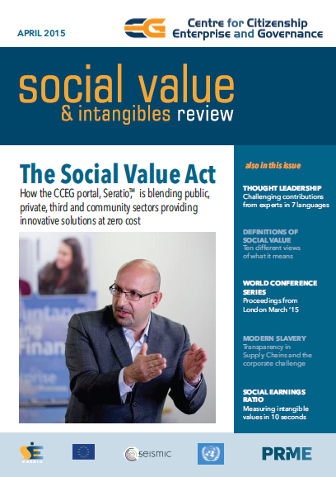
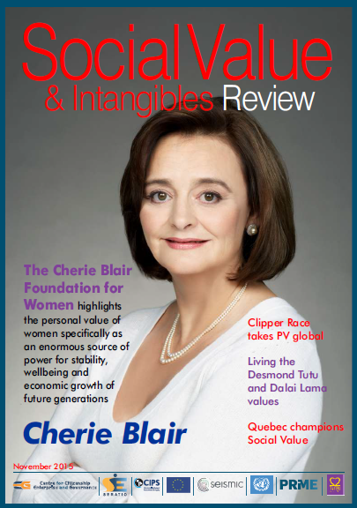
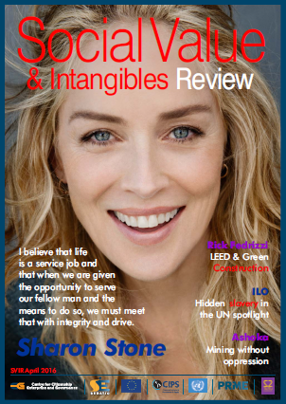
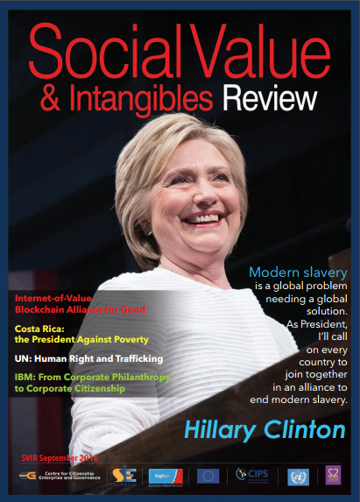
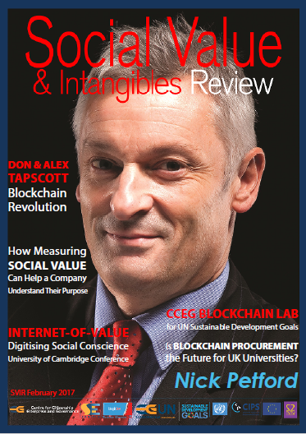
Social value & intangibles review
Journal: https://issuu.com/seratio

Slide 19
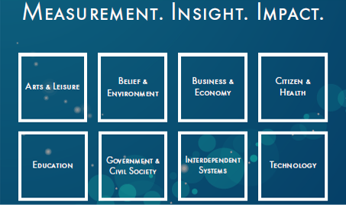
Completed 100+ international commissions
www.socialearningsratio.com

Slide 20
The god metric …The most rapidly adopted social impact metric in the world
Vatican Press (January 2015) http://ow.ly/GPnAi
World Leaders in the supply of Metrics for things that have traditionally been difficult to measure …

Slide 21
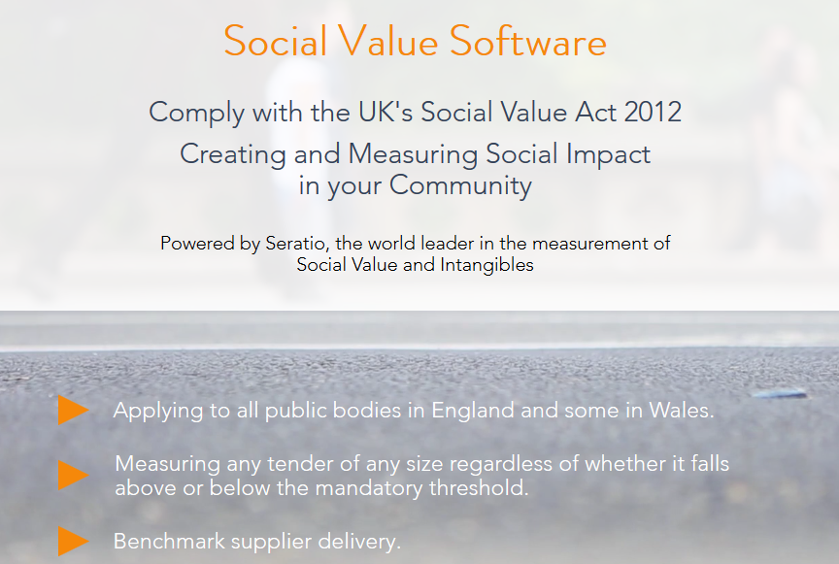
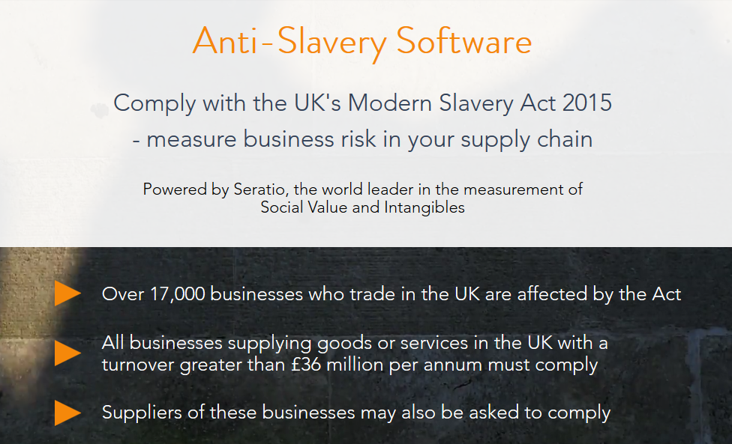

Supply the metrics behind laws
International http://ow.ly/JNxqv
Social Value Act 2012
Modern Slavery Act 2015
5 x EU Commissions
www.publicvalue.online
www.modernslavery.uk
www.socialvalue.eu

Slide 22
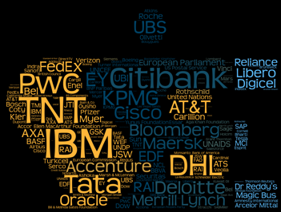

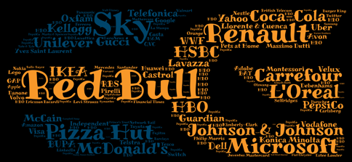

Slide 23


Two Spin out ORGs
Jan 2015: Seratio Limited
Operating in Social Innovation
Software-as-a-Service (SaaS)
Jan 2017: CCEG Blockchain UN Lab
New vehicle in Blockchain
Platform-as-a-Service (PaaS)
www.seratio.com
http://mypad.Northampton.ac.uk/cceg

Slide 24

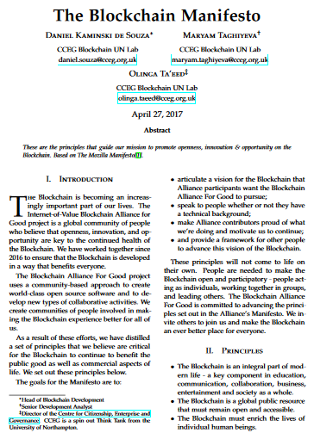
Industry bibles through consensus
Social Value in Public Procurement
The
Blockchain Manifesto
http://ow.ly/CbFUa
http://ow.ly/BKIl30bOD1t

Slide 25

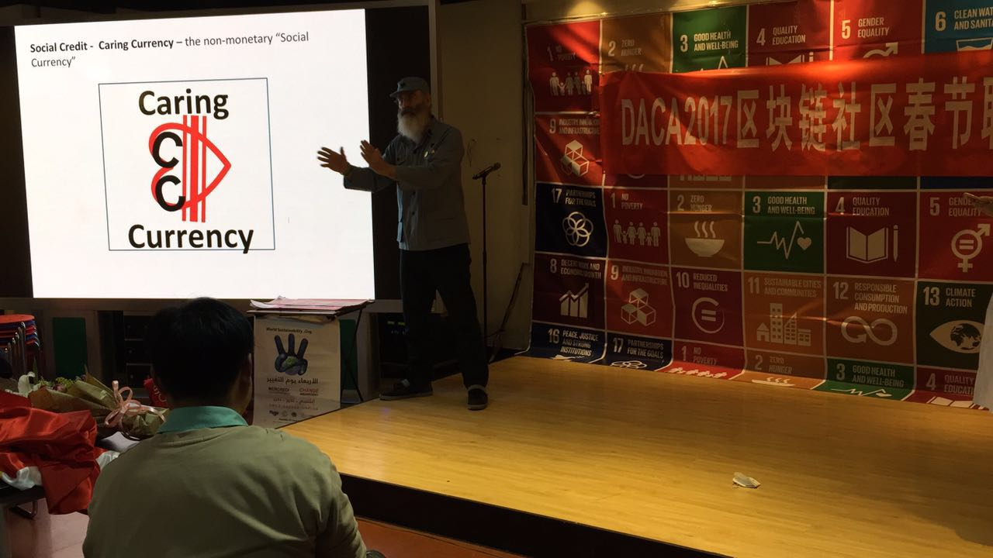
OFFICES: London – New York - Shanghai
Fordham University IIHA
http://ow.ly/v5Nq30dtD9t
Shanghai Office
to manage university partners

Slide 26
Seratio based TOKENS
Seratio ICO
Commissioned Coins
Private Placement: 15 July 2017
Pre-ICO: 15 Sept 2017
ICO: 1st Oct – 31 Oct 2017
www.seratio-coins.world
Carers Coin
City Coin
EduCoin
Islamic Coin
Leadership Coin
SDG Coin
Water Coin
Women’s Coin

Slide 27
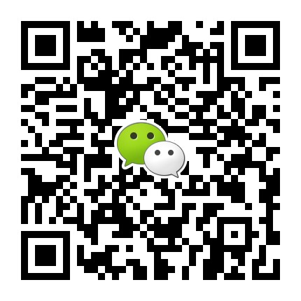
#goodistrending
Olinga.taeed@cceg.org.uk
whatsapp: +44 7715 806318 @olingataeed skype: olingataeed

